Slide 1
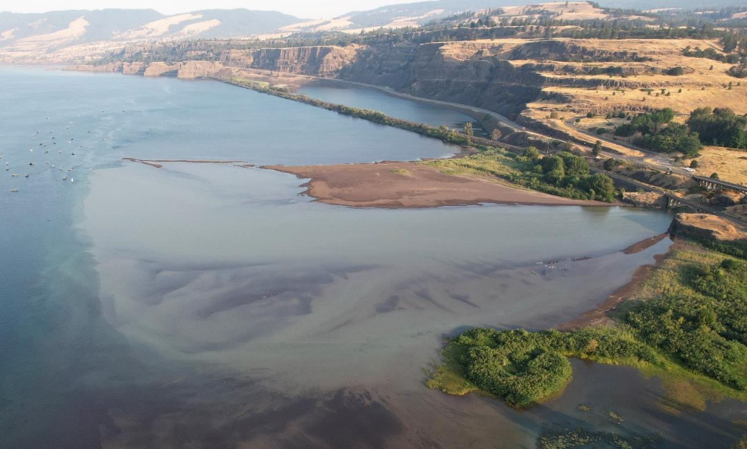
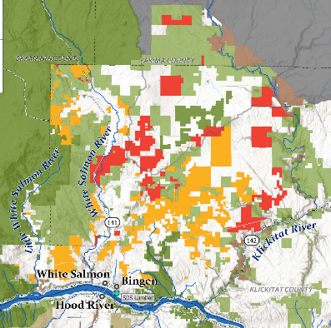
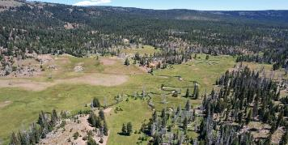
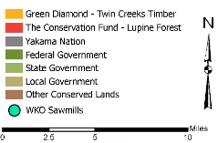
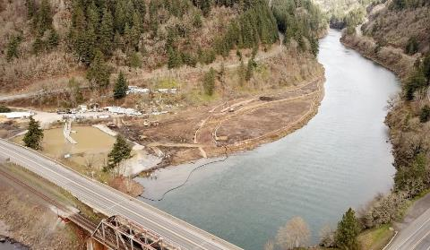
Klickitat Headwaters
Klickitat Delta
ISAB Climate Resiliency Briefings and Panel
January 30, 2025
White Salmon Delta - 2019
Bill Sharp, Yakama Nation Fisheries
Charles Seaton, Columbia River Intertribal Fish Commission

Slide 2
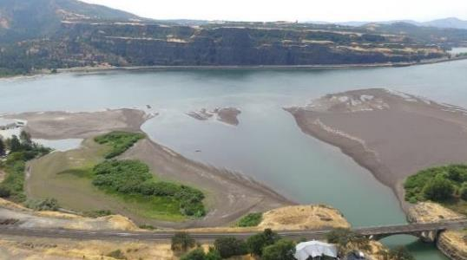
Columbia River Hydrosystem Sediment Impacts
Prior to Bonneville Dam (1935) the Columbia River transported 16.4 million tons of sediment each year.
Despite a significant increase in soil runoff from agriculture and other human development, only around 8 million tons of Columbia River sediment reaches the Pacific Ocean each year.
These changes are particularly noticeable at the mouths of tributaries in the impounded pools.
Where still water of a reservoir can no longer carry much sediment, which quickly settles, creating a sediment fan or delta.
Significant deltas have formed at mouths of the Klickitat, Hood, White Salmon, Wind, and Deschutes Rivers.
Klickitat Delta.

Slide 3
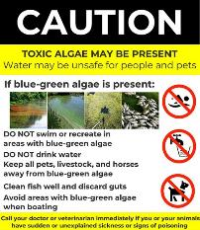
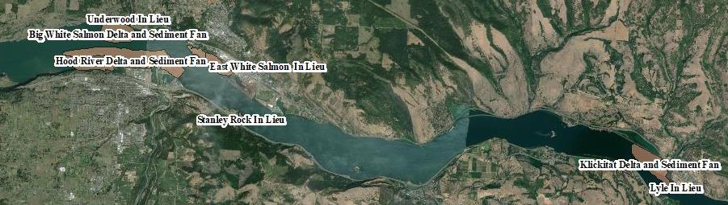
Sediment Negatively Impacts Treaty Fishers
Sediment can impede both scaffold-based and boat-based tribal fishers.
Traditional fishing holes become filled in.
Navigation hazards are created:
  Sand bars appear in new locations.
  Changes to the river flow create unpredictable currents, increasing risk for fishers.
Build-up at in-lieu treaty sites restricts access to docks and boat launches.

Slide 4
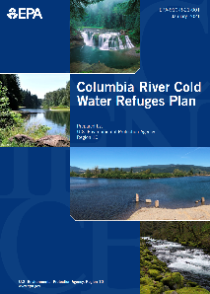
EPA’s 2021 Columbia River Cold Water Refuges Plan
Zone 6 Hydro Dams | River Mile | Dist. to upriver dam | EPA Priority CWR w/in Zone 6 Refuge Volume– ranking (1-13)
Bonneville Dam | 146 | 46 | Little White Salmon River (2nd) Klickitat River (5th) Herman Creek (6th) White Salmon River (7th) Wind River (8th) Hood River (11th)
The Dallas Dam | 192 | 24 | Deschutes River (3th)
John Day Dam | 216 | 76 | None
McNary Dam | 292
Zone 6 Col. River summer temps. are predicted to rise. August mean temps are predicted to be near 23°C by 2040 and ~24°C by 2080.
Optimal adult migration, 12-16°C. Adverse effects begin above 18°C and w/ exposure time.
State water quality criteria, 20°C max. for Zone 6 of the Columbia River.
Notes:
Zone 6 Columbia River summer temperatures are predicted to continue to get warmer. August mean temperatures are predicted to be near 23°C by 2040 and approximately 24°C by 2080.
Optimal temperatures for migrating adult salmon and steelhead are in the 12-16°C range with minimal adverse effects below 18°C (EPA 2003). Both the States of Oregon and Washington have a 20°C maximum water quality criteria for the Lower Columbia River
as temperatures rise above 18°C. The temperature ranges in Table 4-1 represent average river temperatures with multiple day exposure. In general, as temperatures rise, disease risk, stress, energy loss, avoidance behavior, and mortality rates increase. Sockeye are most susceptible to warm temperatures with limited mortality at 19-20°C and significant mortality at 20-21°C. Steelhead are also susceptible to these temperature ranges but exhibit avoidance behavior by seeking cold water refuges (CWR) as is demonstrated in this Plan. Chinook are more tolerant to warm temperatures, with avoidance behavior (seeking CWR) and mortality occurring at higher temperatures (21-22°C and higher).

Slide 5
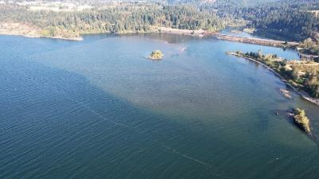
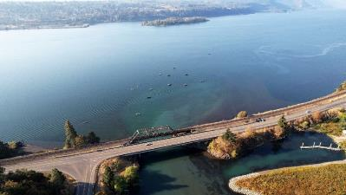

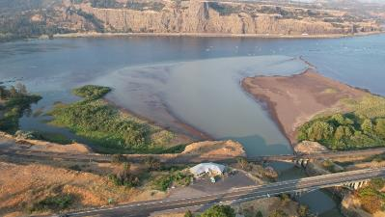

Columbia River Zone 6 Delta Assessment
Technical Assistance Agreement
USACE – Portland Dist. &
Yakama Nation
August 2022
Wind River Delta
White Salmon Delta
Klickitat River Delta
Notes:
CRITFC/USACE Columbia River Zone 6 Delta Assessment
The Columbia River Inter-Tribal Fish Commission (CRITFC) and its member tribes (the Yakama, Nez Perce, Umatilla and Warm Springs) request assistance from the U.S. Army Corps of Engineers, Portland District with an assessment of sedimentation, and its impact on salmonids and Pacific lamprey and cold water refuges, at the confluences of the Klickitat, Deschutes and Wind River tributaries in Zone 6 of the Columbia River between Bonneville and McNary Dams. Interim and final products for each task will be shared between USACE and CRITFC and regular coordination meetings will be scheduled at least quarterly to discuss overall study progress.
Task 1 – Develop Delta Specific Problem Statements
Each tributary confluence likely has its individual characteristics and potential approaches for assessment and modifications, thus data collection and individual tool development will need to occur on a confluence-by-confluence.
Conduct a planning charette with stakeholders and subject matter experts to identify problems, opportunities, objectives, goals and constraints associated with each tributary. Identify similarities and difference between systems that allow for a tailored approach to address identified problems.
Task 2 – Conduct Literature Review
Focus efforts on existing flow, temperature, sediment, morphologic, river stage and native fish impact data or assessments. Possibly include literature review on climate change impacts relevant to these parameters may also be important to highlight research gaps in this regard.
Look for documentation on large sediment supply events and observed impacts. For example, dam removal (like Condit Dam), atmospheric events (like 2006), landslides, tributary delta changes. Possibly add a sub-task for documentation of artificial events in the river tributaries (dredging, riparian island formation, engineering structures, channelization, etc.).
Task 3 – Conduct Geomorphic Assessment
Perform a comparison of historical aerial imagery to characterize changes to shoaling over time.
Assess changes and trends in the backwatered tributary and depositional fan over the time frame from the development of the mainstem Columbia Dams to current. Include potential depths of deposition, impacted tributary length, periodicity of changes in the depositional fans.
Task 4 – Coordinate Bathymetric Data Collection with NOAA
Provide coordination to ensure that data is collected over a sufficient domain and in a form required to support future modeling and analysis efforts.
Task 5 – Compile existing data sets and identify further data needs
Compile all existing flow, sediment, temperature, and miscellaneous data required for analysis and analyze for quality and completeness.
Task 6 – Develop monitoring plans for each delta (temp, sediment, and turbidity)
Based on identified problems and data limitations, develop a monitoring and data collection strategy including timing, duration, and locations for data collection specific to each delta.
Task 7 – Execute monitoring and data collection plans (potential monitoring activities identified below)
Collect tributary flow and river stage data if existing flow data is insufficient or lacking. Establish a flow gaging station and collect 15–30-minute stage and flow data for a single water year to include low and high flow ranges.
Collect bed sediment data to characterize sediment gradation and potential contaminates within the depositional plume. This mill be a minimum of 12 samples collected at each depositional fan or depositional backwatered river feature.
Collect river temperature data if existing temperature data is insufficient or lacking. Establish a temperature gaging station and collect 15–30-minute water temperature data for a low flow and high flow periods of single water year.
Temperature data in the tributary cold water refuge plume for a low flow, high mainstem Columbia condition. Collect point temperature data at multiple water depths to characterize the extents and quality of the existing condition cold water refuge plume. Data will be used to qualify the cold-water plume and to calibrate modeling efforts. Data collection will occur while continuous river flow and temperature data collection occurs in tasks 4 and 6.
Collect suspended sediment concentration (SSC) data if existing SSC samples are insufficient or lacking. Data will be used to establish sediment budgets and quantify suspended sediment loads for sediment transport modeling and alternative assessments. Data collection will be during higher flow periods, up to the highest available flow, in a single water year. Data collection will be continuous with flow and temperature data in tasks 4 and 6.
Task 8 – Develop a modelling and monitoring strategy for each delta
Develop a specific, detailed modeling and monitoring strategy at each of the three named tributaries that is informed by project objectives and specifics of each cold water refugia.
Estimated Study Budget

Slide 6
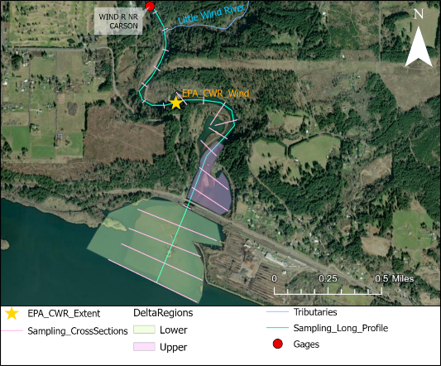
Data Synthesis and Collection
Data Synthesis
Sources include USGS, USEPA, USACE, CRITFC, YN, NOAA, WA Dept. Ecology, WA Dept. Fish and Wildlife, Columbia River DART, NMFS, USFS NorWeST, OSU, UCD
Water temperature, flow, depth, suspended sediment, turbidity, fish metrics, bathymetry, topography, imagery, habitat characterization
Data types include gage timeseries, synoptic sampling, research studies, planning reports, surveys, remote sensing
Data Collection
Scope and funding set for USGS to install turbidity and temperature sensors in May 2024 at
  Wind River near Carson (14128500)
  White Salmon near Underwood (14123500)
  Klickitat River near Pitt (14113000)
Scope development for August 2024 synoptic sampling
  Temperature depth and cross sections
  Water depths
  Sediment characterization

Slide 7
Outcomes, Key questions & next steps
Main outputs from Delta Assessment Study
  Historical context on how Bonneville Pool and previous flood events have affected sedimentation in the CWR habitats
  Characterize current physical conditions of CWR habitats
  Establish continuous monitoring of tributary flows, water temperature, and turbidity
    Set up for future projects to establish suspended sediments-turbidity correlation
    Establish data sets needed for modeling efforts to guide management and restoration
  Future uses of the Delta Assessment Study information and key questions that can be addressed
  What are the opportunities for restoration or modification of the delta areas?
  Define the types of modifications that need to be considered to provide ecological benefit
  How does sedimentation interact with/impact the federal navigation channel?
  Understand potential upstream modifications that reduce sediment load.
  Further refine mapping of the cold-water plume.

Slide 8
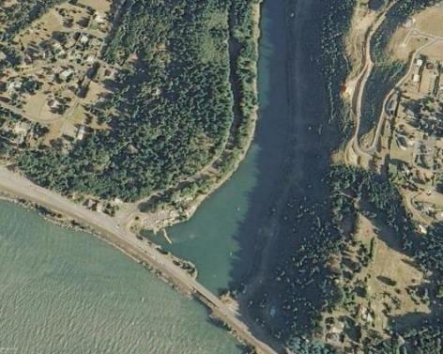
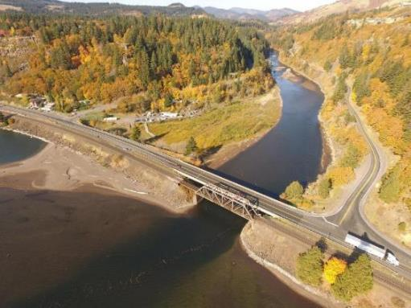
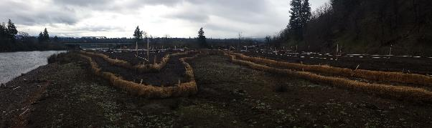
White Salmon River – 2011 before Condit Dam removal (left),
2017 conditions before boat basin dredging (right)

Slide 9
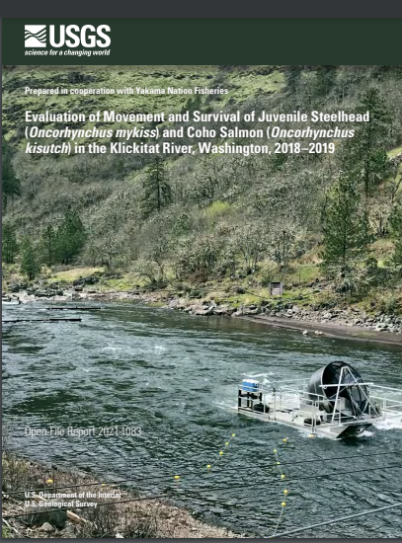
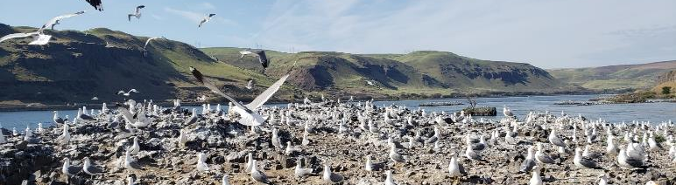
Hydrosystem impacts affecting smolt survival
WATER RESOURCES DEVELOPMENT ACT (WRDA)
TITLE II—STUDIES AND REPORTS
SEC. 1201. AUTHORIZATION OF PROPOSED FEASIBILITY STUDIES.
(a) NEW PROJECTS.—The Secretary is authorized to conduct a feasibility study for the following projects for water resources development and conservation and other purposes, as identified in the reports titled ‘‘Report to Congress on Future Water Resources Development’’
(159) WIND, KLICKITAT, HOOD, DESCHUTES, ROCK CREEK, AND JOHN DAY TRIBUTARIES, COLUMBIA RIVER, WASHINGTON.
Project for ecosystem restoration, Wind, Klickitat, Hood, Deschutes, Rock Creek, and John Day tributaries, Columbia River, Washington.

Slide 10
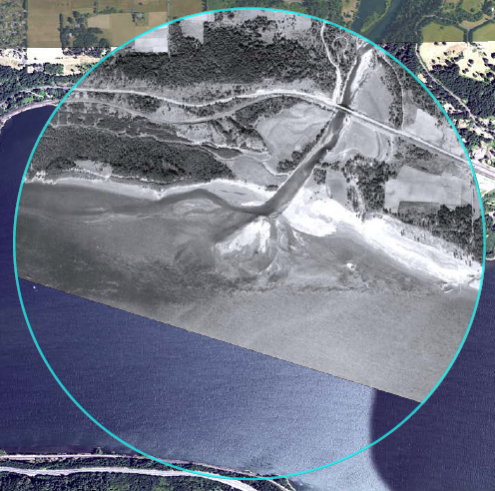
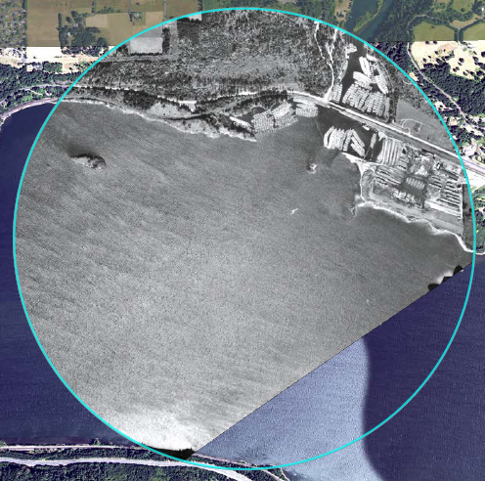
Geomorphic Assessment
Qualitative assessment on the physical changes to tributary delta regions
  Geo-rectify historical aerial imagery over time
  Assess pre- and post-dam conditions
Wind River
Wind River
1935
1969

Slide 11
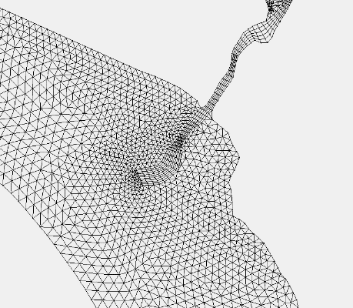
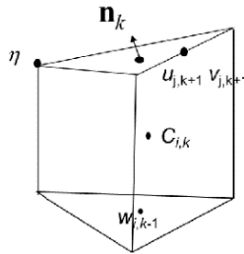
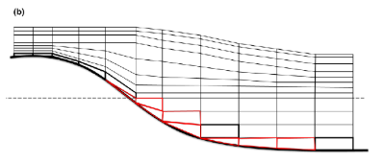
CRITFC-CMOP modeling of the deltas
CRITFC’s Coastal Margin Observation and Prediction program (CMOP) has extensive experience with 3-D hydrodynamic modeling below Bonneville dam
The same modeling methods (SCHISM) can be applied in Zone 6 to evaluate potential modifications to the deltas
3-D modeling requires detailed bathymetry
We model:
Using triangles
and quadrangles
... the world as prisms
In vertical stacks
Notes:
Hydrodynamic models solve physics equations describing the motion of water to predict how water in rivers, estuaries and the ocean behave
Momentum: things in motion stay in motion, things at rest stay at rest, unless acted on by an outside force
Continuity: if more water comes in than goes out, water go up
Transport: stuff in the water moves with the water
Equation of state: salt makes water denser, heat makes water less dense, pressure makes water a little more dense
Physics equations are made solvable by splitting the world into discrete pieces
We model the world using triangles and quadrangles that allow us to increase resolution in areas of interest
Vertically, we resolve the world into layers, creating stacks of prisms
Bathymetry of the deltas and bank to bank bathymetry for the Columbia was lacking
CRITFC is working with NOAA-OCS, GCAP, and Cayuse Native Solutions to acquire new bathymetry for the area

Slide 12
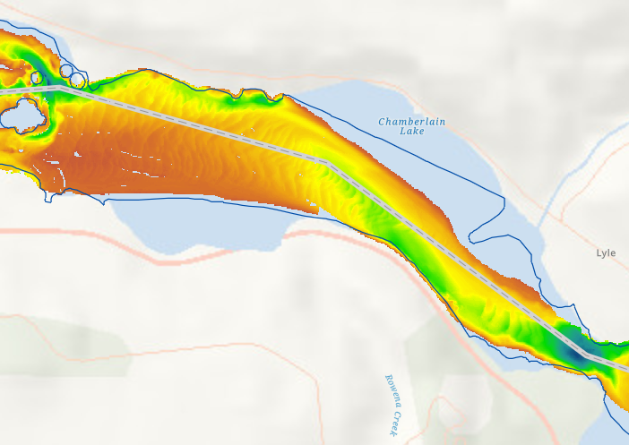
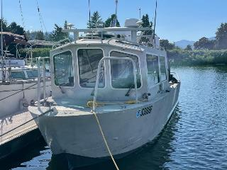
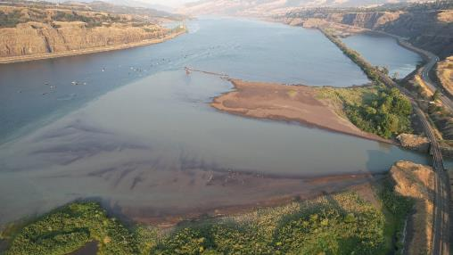
NOAA-Office of Coast Survey. 2022 bathymetry coverage.
Klickitat River Delta
https://storymaps.arcgis.com/stories/ffaae163a1054ef2880dcdd492bb5ec1

Slide 13
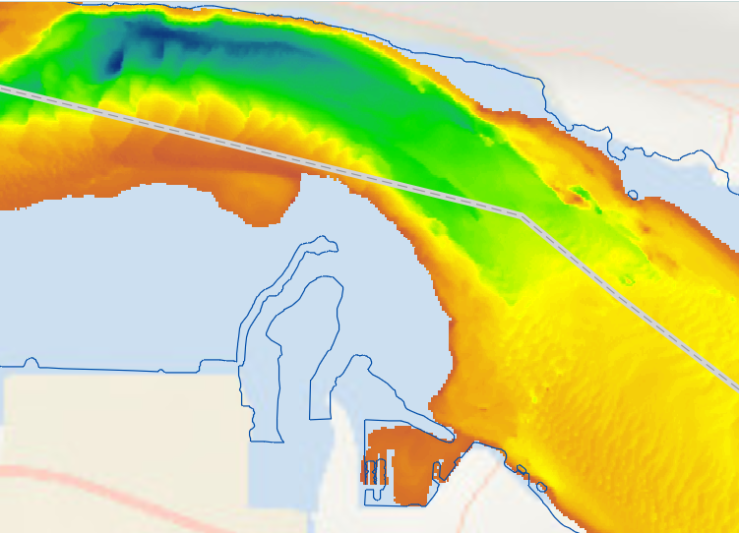
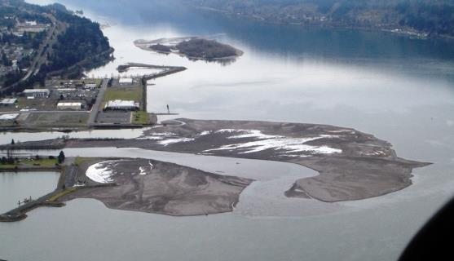
Hood River Delta
CTBWSR & COE-Portland
Juvenile Survival Study
Project Assistance Agreement
… OCS survey limited to minimum depth of 4 meters

Slide 14
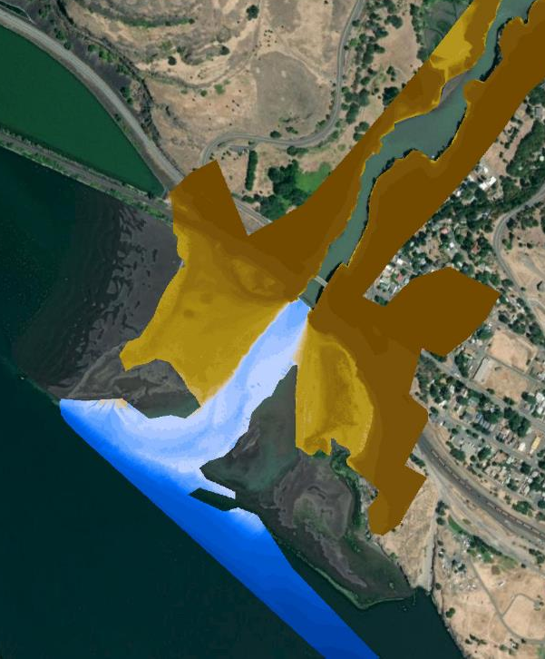
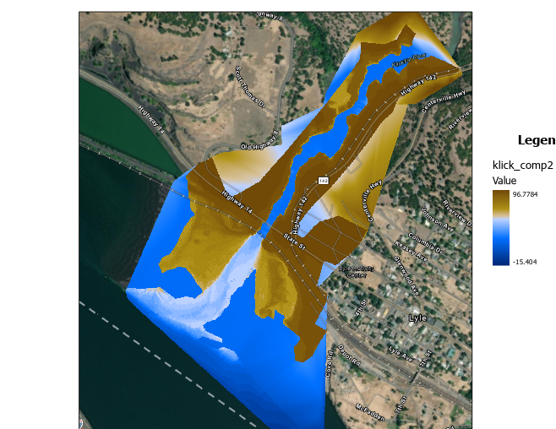



Composite Bathymetry
2022
Bathymetry from NOAA-OCS surveys is not available yet
Composite topo-bathy DEM generated from:
  LiDAR survey conducted by Cayuse Native Solutions
  2022 sonar bathymetry survey conducted by CRITFC and Dr. Chris Parish (OSU)
Additional sonar surveys of Klickitat delta were conducted as part of GCAP in 2024
Development of initial version of Zone 6 hydrodynamic model waiting for NOAA-OCS survey data (2022,2023, 2024 surveys)
40
25
24
23
Height (m)
23
22
20
10
GCAP = Geospatial Center for the Arctic and Pacific

Slide 15
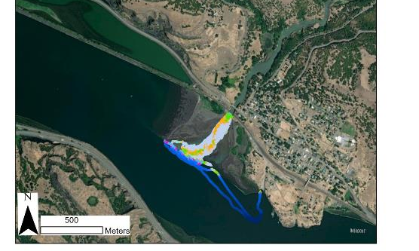
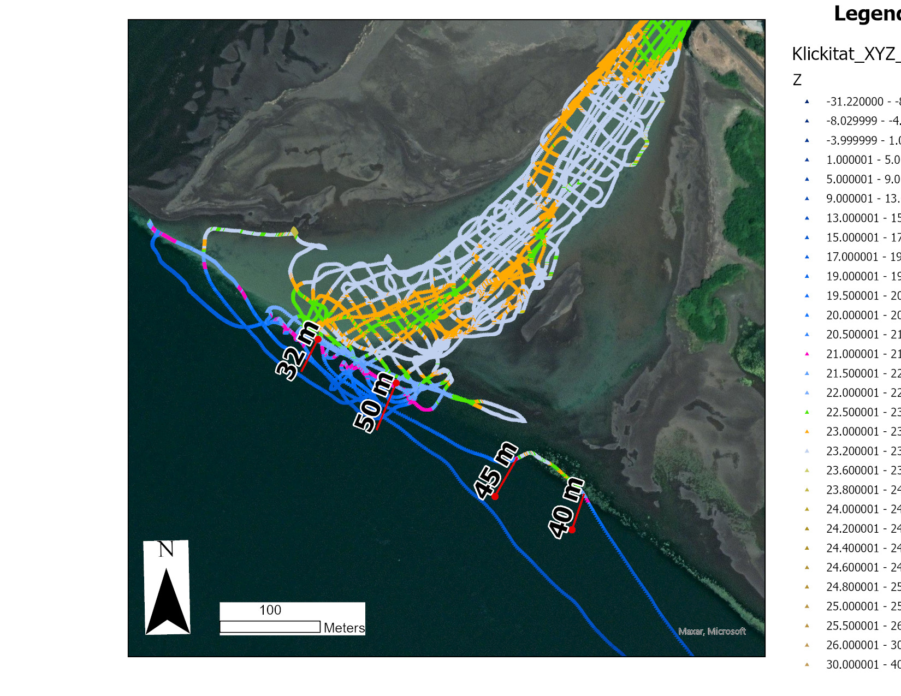
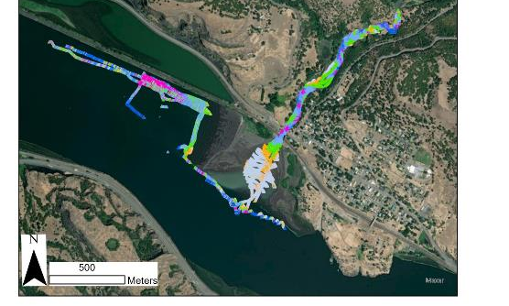
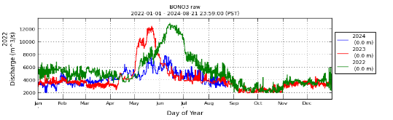
2024 Bathymetric surveys
2022
Conducted in August and September
Extended survey area upriver to end of slack water and west of the delta
Repeated survey of interior of delta and edge of delta
Comparison of 2022 and 2024 shows significant changes between years
2025 surveys will be conducted over multiple seasons (pre-freshet and fall)
to evaluate seasonal variation
2024 freshet was weaker than 2022 and 2023 (< 8000 m^3/s vs > 12000 m^3/s, 225 vs 340 kcfs)
2024
Height above geoid (m)

Slide 16
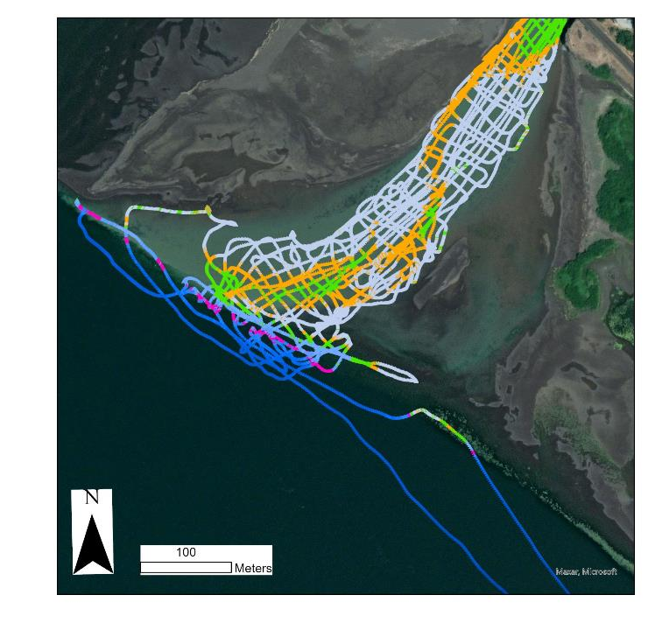
Interannual Comparisons
2022
Comparisons of Klickitat Delta surveys between 2022 and 2024 show major changes in:
  channel depth,
  channel shape,
  delta bank
  extent of delta nose
Height above geoid (m)

Slide 17
Interannual Comparisons
2022
Comparisons of Klickitat Delta surveys between 2022 and 2024 show major changes in:
  channel depth,
  channel shape,
  delta bank
  extent of delta nose
Height above geoid (m)

Slide 18
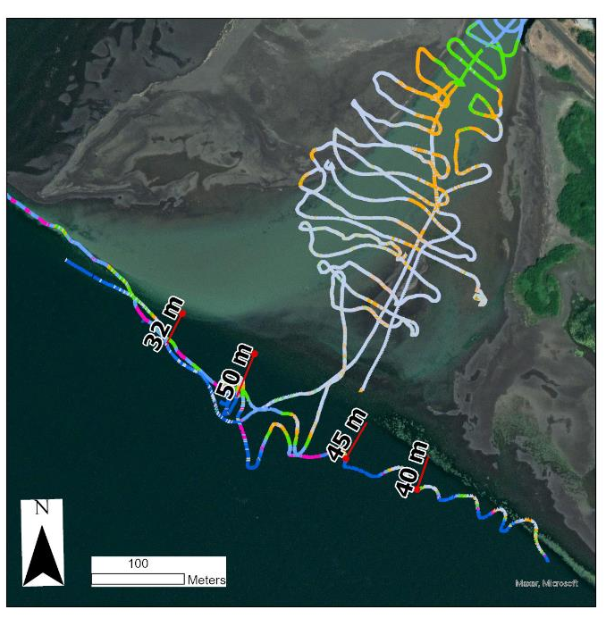
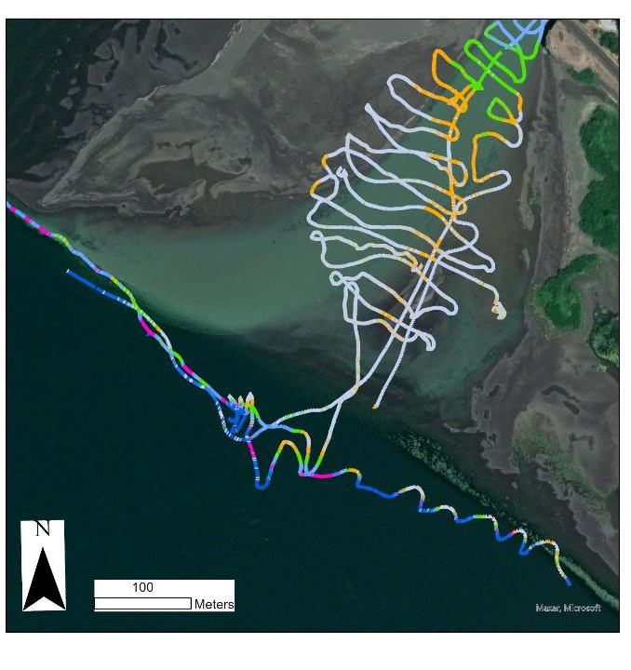
Interannual Comparisons
2024
Comparisons of Klickitat Delta surveys between 2022 and 2024 show major changes in:
  channel depth,
  channel shape,
  delta bank,
  and extent of delta nose
Height above geoid (m)
Height above geoid (m)

Slide 19
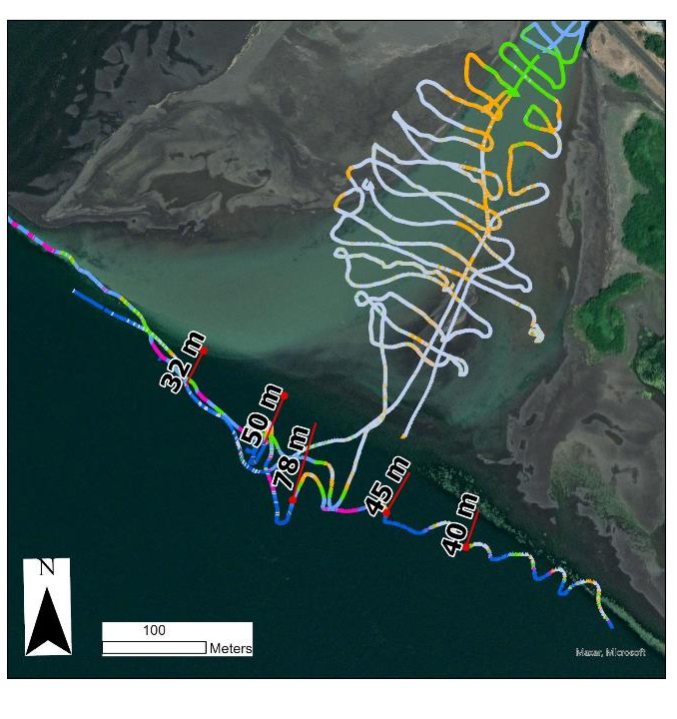
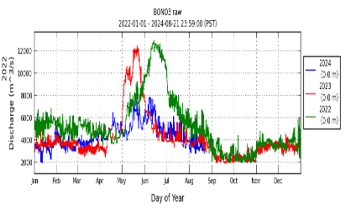
Interannual Comparisons
2024
Comparisons of Klickitat Delta surveys between 2022 and 2024 show major changes in:
  channel depth,
  channel shape,
  and extent and shape of delta nose
Channel is shallower and simpler
Inundation is broader
Delta nose has extended 50m
further into Columbia
Height above geoid (m)

Slide 20
THORR – Thermal History of Regulated Rivers
Key research Questions that THORR is currently being used to answer for CRITFC with UW collaboration:
    To what extent can temperature changes due to regulation be attributed to the changes in fish abundance?
How does the historical trend of water temperature relate to fish processes such as migration,
reproduction, and abundance?
• How can we optimize reservoir operation to protect the fish population?

Slide 21
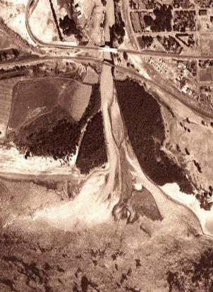
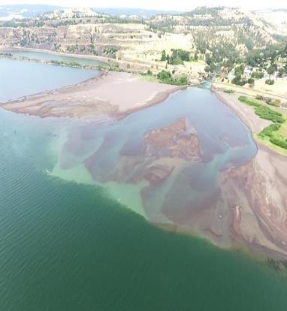
Klickitat River – Delta

